Slide 1

Library Management System
Agrim Deswal
Vipul Chitral
Prabhjot Singh

Slide 2
What is LMS?
This Information management system implements a library management system application that solves a real-world problem.
Library management system is an automated system that allows librarians to manage the resources and services provided by a library. It is a crucial tool for libraries to maintain accurate records, monitor and manage resources, and offer efficient services to users.

Slide 3
Features of Library Management System
Cataloging: Library management systems provide a centralized database for cataloging library resources, including books, periodicals, and other materials.
Circulation: Library management systems automate the process of checking books in and out of the library, reducing errors and improving efficiency.
Reports: Library management systems generate reports on resource usage, circulation, and other key metrics that librarians can use to make informed decisions.

Slide 4
DESIGN
The business model folder (BLL) consists of 3 internal classes for books, author, and client.
These classes contain get/set for their respective fields.
The Data folder (DLL) holds methods for various CRUD operations and connection to database.
List
Save
Search
Exit

Slide 5
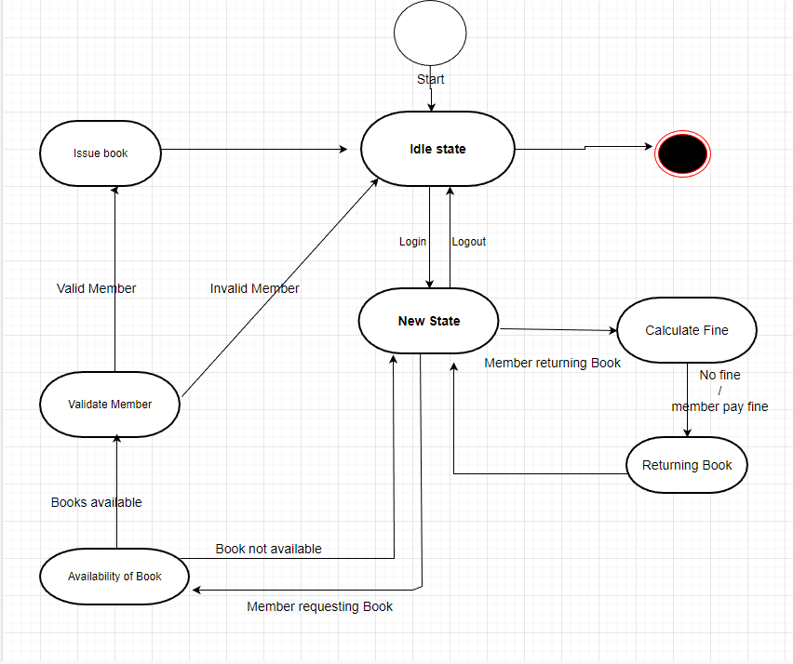
State Machine Diagram

Slide 6
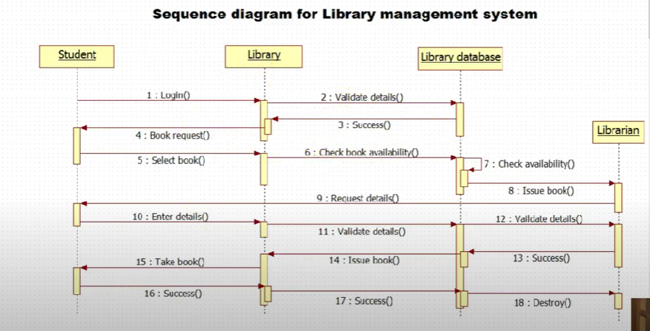
Sequence Diagram

Slide 7
Validation
The validation folder carries various validation methods for different methods.
Valid ID should be 3-digit number or string
No numbers in name.
ID should be unique

Slide 8
Conclusion
The Library Management System is an essential tool for libraries to manage their resources and offer efficient services to their patrons. The system will be a desktop application built on Visual Studio using C#. The system will offer features such as cataloging, circulation, reservations, user management, and reporting. The implementation of the system will involve requirements gathering, system design, development, testing, deployment, and training. By implementing the LMS, the library staff will be able to manage resources and offer efficient services to their patrons, improving their overall operations.

